Slide 1
WEB 322 WEB PROGRAMMING TOOLS AND FRAMEWORKS
Week 10 – Lecture 1
Authentication & Authorization

Slide 2
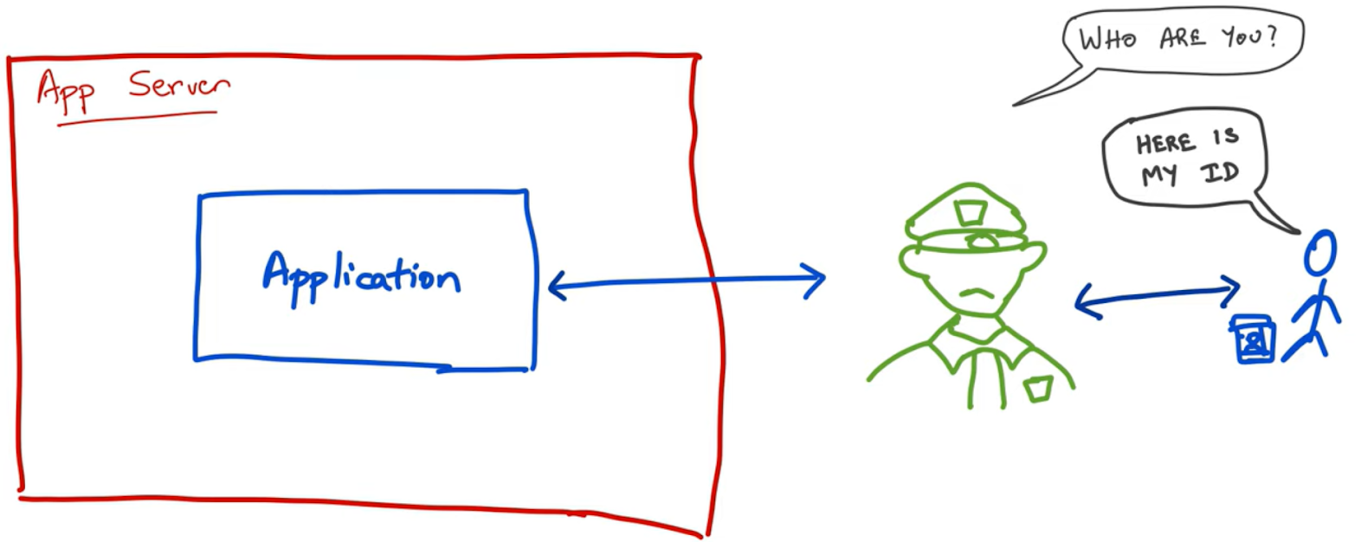
Authentication
The process of determining whether someone or something is who or what they declare to be.
A common way that apps handle security.
Provides access control for systems:
Checks to see if a user's credentials match the database.
For example, username or email, and password match the credentials in a database of authorized users.

Slide 3
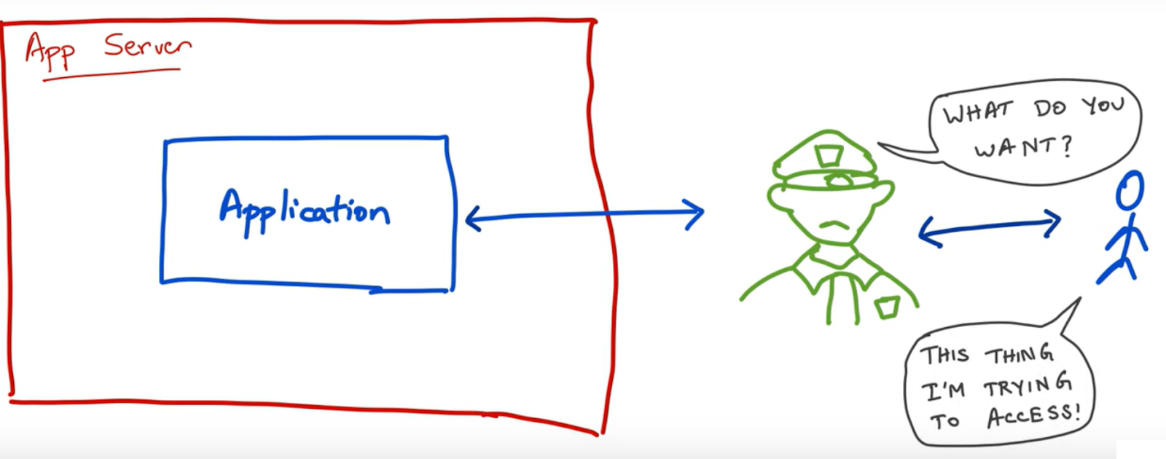
Authorization
Occurs after your identity is successfully authenticated by the system.
Decides what a user can do and the resources (such as information or files) they can access.
In other words, authorization determines whether the authenticated user has access to particular resources.
For example, a customer and employee may have access to a different dashboard in a web application.

Slide 4

Authentication
Who is this user?
Authorization
Are they allowed to do this?

Slide 5
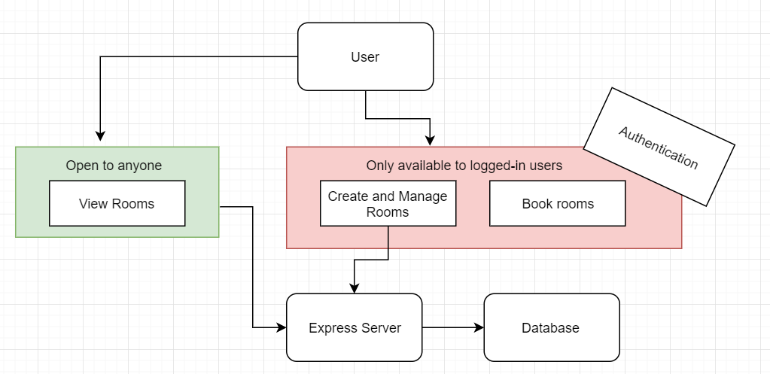
Importance of Authentication
Some pages are accessible to all visitors of the website.
Other pages are restricted to registered users.
To view restricted pages, users need to authenticate, or login, to prove their identity.

Slide 6
Cookies
Pieces of data that are passed back and forth from the browser to the server.
Used to hold ‘state’ information.
Cookies are not set and maintained automatically. It is the responsibility of the programmer.
Server sends the “Set-Cookie” header to add a cookie to the browser.
On each request, the browser will include a “Cookie” header with all stored cookies for the domain/path.

Slide 7
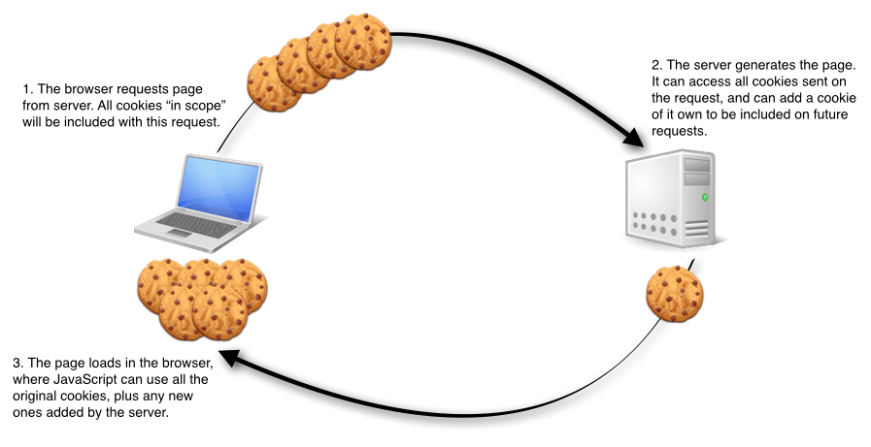
Cookies Lifecycle

Slide 8
Session-Based Authentication
Session-based authentication is the de facto standard for handling user authentication.
How it works:
The client posts the login credentials to the server.
The server verifies the credentials.
If validation passes, the server creates a session (on the server) and returns a session ID via a “Set-Cookie” header.
On subsequent requests, the client must continue to pass the session id to the server.
During each request, the session id is verified by the server and the request will be processed.
Upon logout, the session id will be cleared from both the client cookie and server.

Slide 9
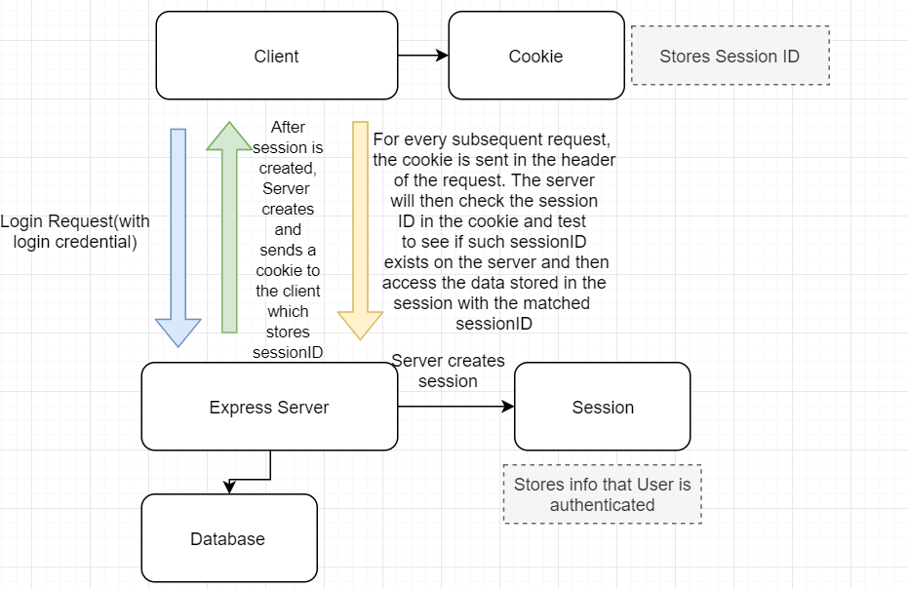

Slide 10
Sessions in Node.JS with Express
Install a 3rd party package called “express-session”.
Require the module: require('express-session’);
Configure the middleware.
app.use(session({ secret: “…”, resave: false, saveUninitialized: true }));
app.use((req,res,next)=>{
// After a session is created, inject data into views.
res.locals.user = req.session.user;
next();
});
To store or access session data, use the request property, for example: req.session.user
To clear a session, call the destroy method from the session property, for example: req.session.destroy();

Slide 11
Encrypting Passwords
Passwords should never be stored in plain text!
Passwords can be encrypted or hashed (preferable).
There are many hashing and encryption algorithms available.
In this course we will use bcrypt
A popular encryption module for JavaScript.
Secure way to store passwords in a database.
Works in two steps:
Generates a salt (a random piece of information).
Hashes the password using the salt.
The salt allows for a unique hash for each password (even if two users have the same password).

Slide 12

Live Demo
Express App
Authenticate users.
Authorize users.
Create new sessions.
Clear sessions.
Encrypt passwords.

